Slide 1




2025 NASA Space Apps Challenge
SPACE YATRA
A Journey to Explore Space Weather
Presented by
Bit2Byte

Slide 2

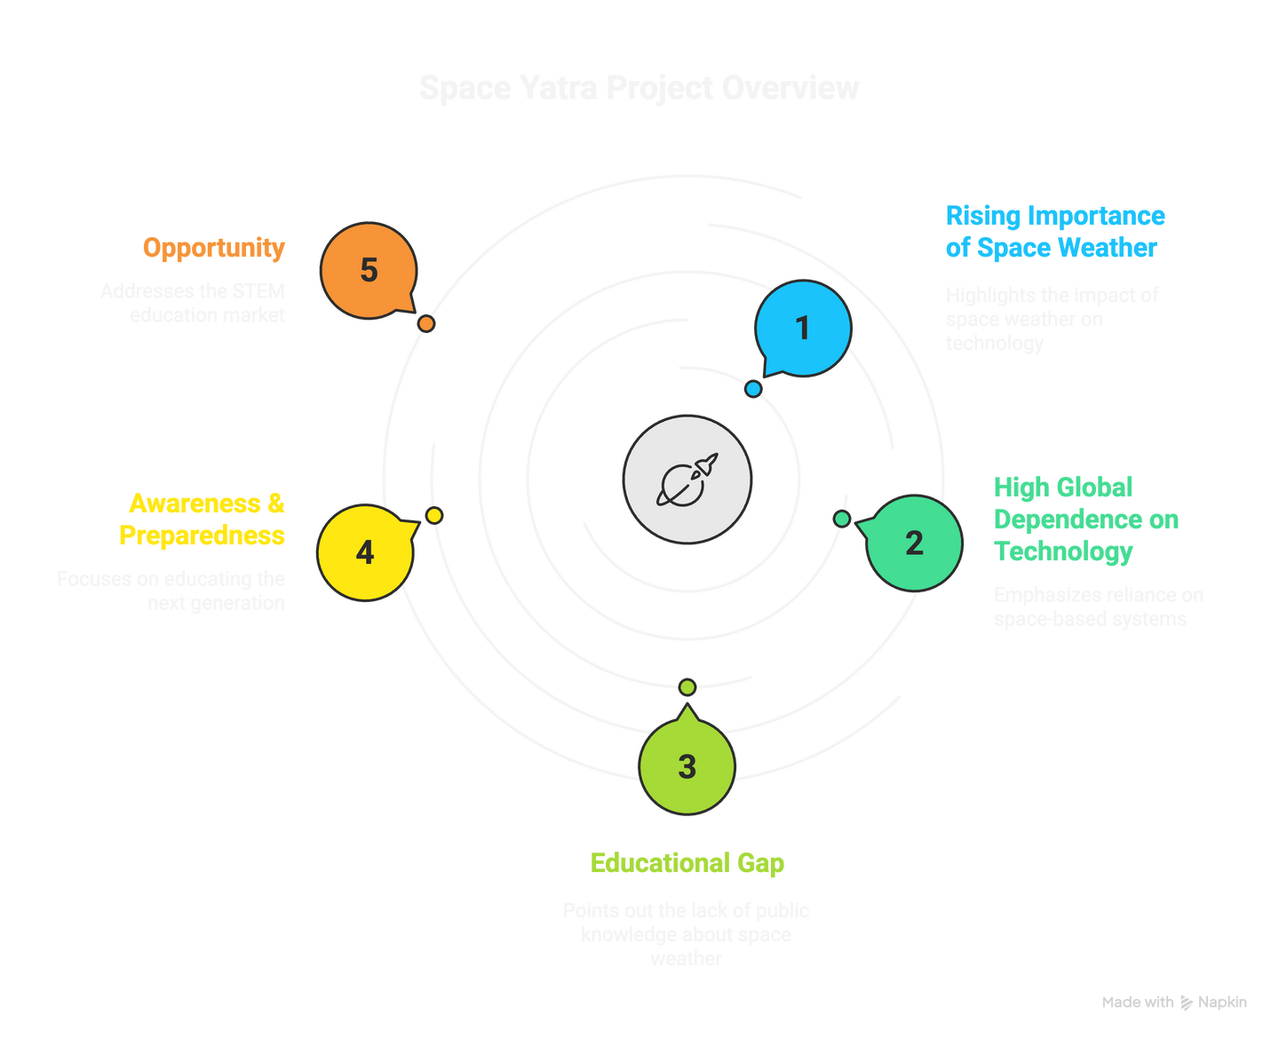
Why We Selected this Project
Rising Importance of Space Weather: Space weather events (like solar flares and CMEs) can disrupt satellites, GPS, aviation, internet, and even power grids.
High Global Dependence on Technology: In today’s digital era, everything from navigation apps to online banking relies on space-based systems.
Educational Gap: Most people, especially children and students, don’t know what space weather is or how it impacts their lives.
Awareness & Preparedness: By educating the next generation through a fun, interactive platform, we build awareness, curiosity, and future readiness.
Opportunity: Space Yatra addresses the STEM education market, combining real NASA data with engaging stories and visuals to simplify complex science.

Slide 3
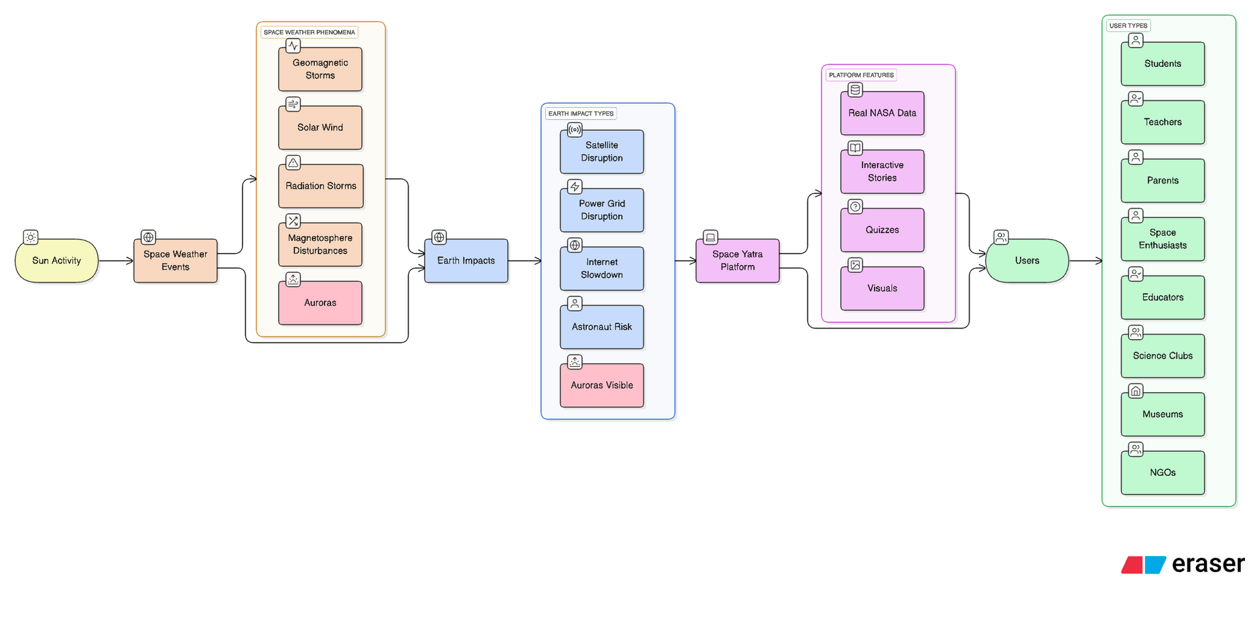
BLOCK DIAGRAM
DATASET LINKS
HTTPS://WWW.NASA.GOV/IMAGES/
HTTPS://SCIENCE.NASA.GOV/CLIMATE-CHANGE/

Slide 4
BUSINESS MODEL CANVAS
KEY PARTNERS
KEY ACTIVITIES
VALUE PROPOSITION
CUSTOMER RELATIONSHIPS
CUSTOMER SEGMENTS
CREATING INTERACTIVE STORIES & VISUALS
INTEGRATING REAL-TIME NASA DATA
PLATFORM HOSTING & MAINTENANCE
QUIZZES, GAMES & COMMUNITY LEARNING
NASA (APIS & OPEN DATA)
SCHOOLS & STEM PROGRAMS
SCIENCE COMMUNICATORS & EDUCATORS
EDTECH COLLABORATORS
FUN, GAMIFIED SCIENCE LEARNING FOR STUDENTS
READY-TO-USE STEM RESOURCE FOR TEACHERS
SAFE, ENGAGING PLATFORM FOR PARENTS
SIMPLIFIED LIVE SPACE DATA FOR ENTHUSIASTS
PARTNERSHIPS WITH SCHOOLS FOR ADOPTION
COMMUNITY-DRIVEN ENGAGEMENT (QUIZZES, CHALLENGES)
FREEMIUM → PREMIUM UPGRADE MODEL
CONTINUOUS FEEDBACK & UPDATES
STUDENTS (8–18 YEARS)
TEACHERS & EDUCATIONAL INSTITUTIONS
PARENTS
SCIENCE & TECH ENTHUSIASTS
KEY RESOURCES
CHANNELS
INTELLECTUAL CONTENT: QUIZES, ANIMATED VIDEOS, NASA DATA VISUALIZED FOR KIDS.
HUMAN: WRITERS, DEVELOPERS, DESIGNERS
FINANCIAL: FUNDS FOR ANIMATION AND MARKETING ETC : SPONSORSHIPS
PHYSICAL: COMPUTERS AND TESTING DEVICES
SPACE YATRA WEBSITE & MOBILE APP
SCHOOL & STEM COLLABORATIONS
SOCIAL MEDIA (YOUTUBE, INSTAGRAM, LINKEDIN)
SCIENCE EVENTS & HACKATHONS
COST STRUCTURE
REVENUE STREAMS
Fixed Costs:
Development: ₹12-20 Lakh ($15-25K)
Annual Operations: ₹2.8-7.6 Lakh ($3.5-9.5K)
Variable Costs:
Per User: ₹5-50 ($0.06-0.60) depending on scale
Content Updates: ₹1-3 Lakh/year ($1.2-3.7K/year)
Cost Structure Type: Value-driven, low-cost model
SCHOOL SUBSCRIPTIONS (B2B)
PREMIUM USER SUBSCRIPTIONS (B2C)
SPONSORED COLLABORATIONS (STEM BRANDS)
MERCHANDISE (BOOKS, POSTERS, GAMES)

Slide 5
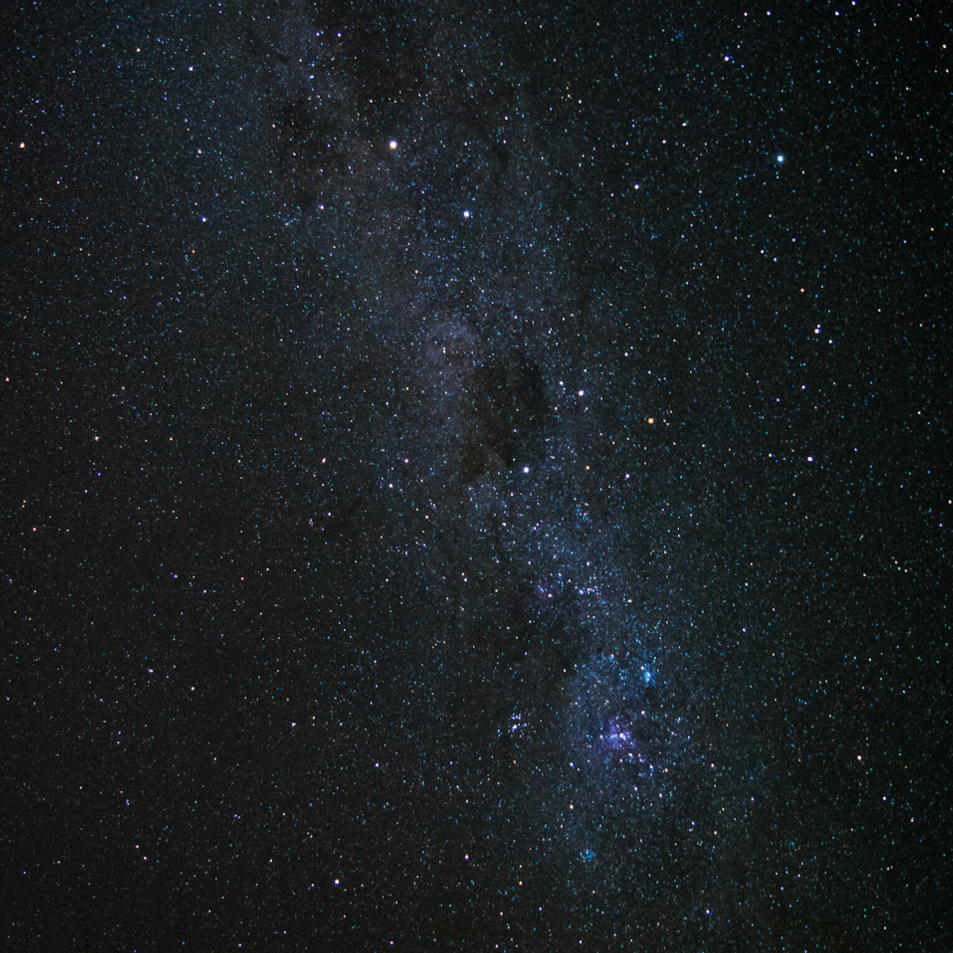

ADVANTAGES AND CHALLENGES
Advantages
How We Minimize Challenges
Makes complex NASA data easy for children.
Uses storytelling → higher retention than plain facts.
Open-source, accessible worldwide.
Multidisciplinary approach (story + design + coding).
Keep story short (6–8 scenes) and visual-heavy.
Balance science + fun → simplify without losing accuracy.
Iterative testing with our team (quick feedback loops).
Optimize for mobile → most kids/parents access via phones.
Challenges
Limited time → story + website may not be highly polished.
Illustrations/data need simplification → risk of losing some scientific depth.
Kids’ attention span is short → risk of less engagement.
Demo Video Link :
https://youtu.be/SUXoZg9MDv0

Slide 6
THANK YOU
“Don’t just read about space - step into the adventure!”

